Slide 1


PES Institute of Technology and Management (Afflicted to Visveswaraya Technological University) Internship Presentation on “ Python Machine Learning for Facial Emotion Detection Using Neral Networks”
SNEHA MANJUNATH [4PM19CS090]
Guide: Coordinator:
Ms. Suchitra H L Dr. Sunitha B S
Prof. Dept of CS & E Assoc. Prof. Dept of CS & E
PESITM PESITM
HoD: Dr. Arjun U
Assoc. Prof and Head of CS & E
PESITM

Slide 2
CONTENTS
Purpose of Internship
Introduction of the Organization
Scheduled Tasks
Machine Learning, Image Processing and CNN
About the project
Methodology and Output
Goals and Objectives of Internship
Results

Slide 3
PURPOSE OF INTERNSHIP
Application of education and career exploration.
To gain experience and networking.
To learn how a professional workplace operates.
To gain professional feedback.

Slide 4

Innovant IT Solutions
Innovant IT Solutions is a software development, IT product sales & service and technical training firm based in Shimogga since 2016. They have extensive experience in many diverse areas of software development.
Their approach focuses on new way of business, thereby combining IT innovations and adoption while leveraging an organization’s current assets.

Slide 5
Vision
To build upon the reputation of being one of the most innovative IT solution & service provider. They believe in doing our work in the most efficient way with robust and structured methodology, with gradual evolution from hard work to smart work culture.
Mission
To produce excellent services in the field of IT services with maximum efforts driven towards customer satisfaction.

Slide 6
SCHEDULED TASKS
Week | Date | Work
Week 1 | 29/08/2022 - 03/09/2022 | Introduction to basic concepts
Week 2 | 06/09/2022 - 10/09/2022 | Literature Survey and collection of requirements.
Week 3 | 12/09/2022 - 17/09/2022 | Algorithm selection and model creation.
Week 1 | 19/09/2022 - 24/09/2022 | Report making and presentation

Slide 7
MACHINE LEARNING
Machine learning is a subset of artificial intelligence that enables computer systems to automatically learn and improve from experience without being explicitly programmed.
It uses algorithms and statistical models to analyze data and find patterns, which are then used to make predictions or decisions.

Slide 8
IMAGE PROCESSING
Image processing is a field of study that deals with the analysis and manipulation of images using algorithms and mathematical techniques. It involves the use of computer algorithms to perform various operations on digital images, such as enhancing image quality, extracting information, and recognizing patterns.
Some of the fundamental image processing steps include image acquisition, image enhancement, image restoration, segmentation, feature extraction, and image classification.

Slide 9
CONVOLUTIONAL NEURAL NETWORK
A Convolutional Neural Network (CNN) is a type of Deep Learning architecture commonly used for image classification and recognition tasks. It consists of multiple layers, including Convolutional layers, Pooling layers, and fully connected layers.
Convolutional neural network models are ubiquitous in the image data space. Its application includes image classification, object detection, image recognition, etc.

Slide 10
FACIAL EMOTION DETECTION USING NEURAL NETWORKS
Facial emotion detection using neural networks is a project that aims to analyze and recognize human emotions from facial expressions.
Neural networks, specifically deep learning models, are employed to train a system to automatically detect emotions from facial images or video frames.
The project involves collecting a labeled dataset of facial expressions, which includes images of individuals displaying different emotions.

Slide 11
The dataset is then used to train a deep neural network, typically a convolutional neural network (CNN), to learn patterns and features associated with each emotion.
The CNN model undergoes a training process where it adjusts its internal weights and biases to minimize the difference between predicted emotions and the ground truth labels in the training dataset.
Once the model is trained, it can be deployed to detect emotions in real-time or on new unseen images or video frames.

Slide 12
During the detection phase, the trained model processes facial images or frames, extracts relevant features, and classifies them into different emotion categories such as happiness, sadness, anger, surprise, etc.

Slide 13
METHODOLOGY
Deep Learning
Tensorflow
Keras
OpenCV
Neural Networks
Tkinter

Slide 14
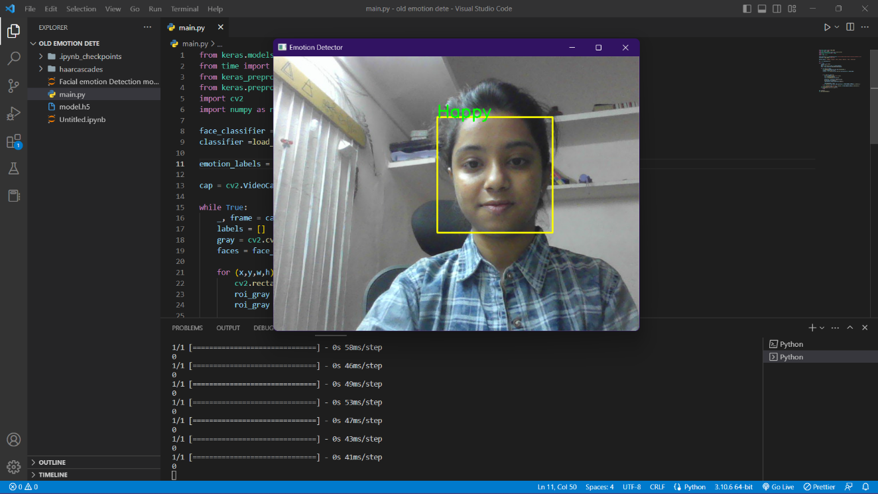
OUTPUT
Fig.1 : Output Recognizing emotion as Happy.

Slide 15
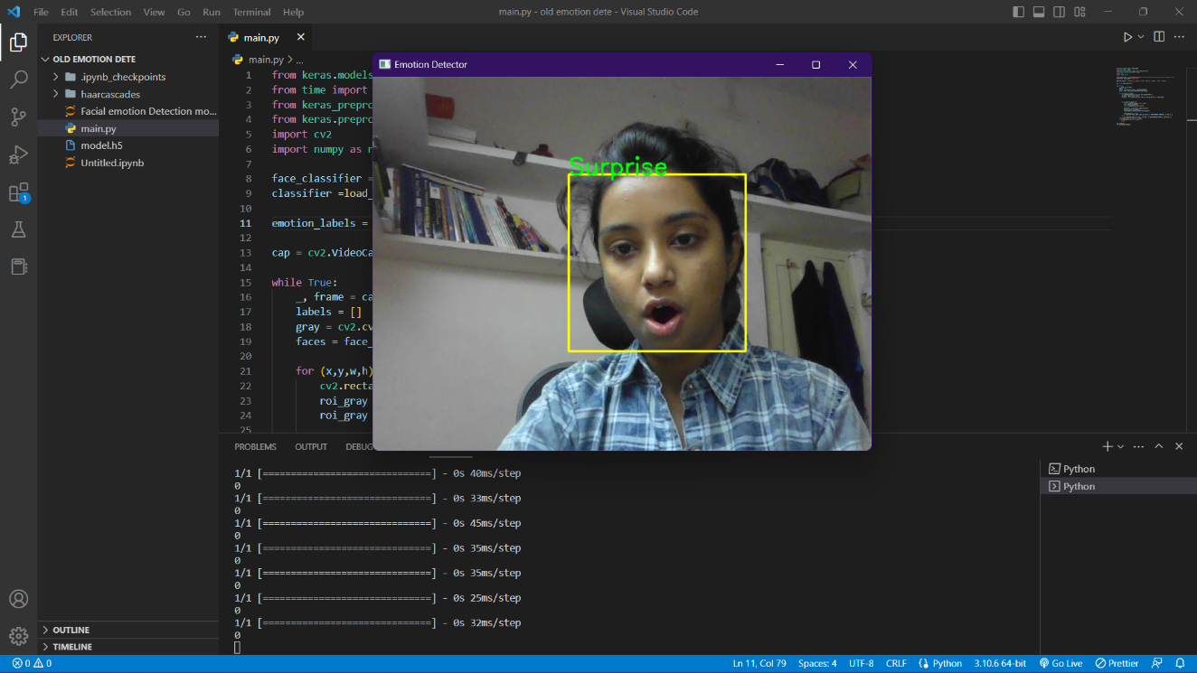
Fig.2 : Output Recognizing emotion as surprise.

Slide 16
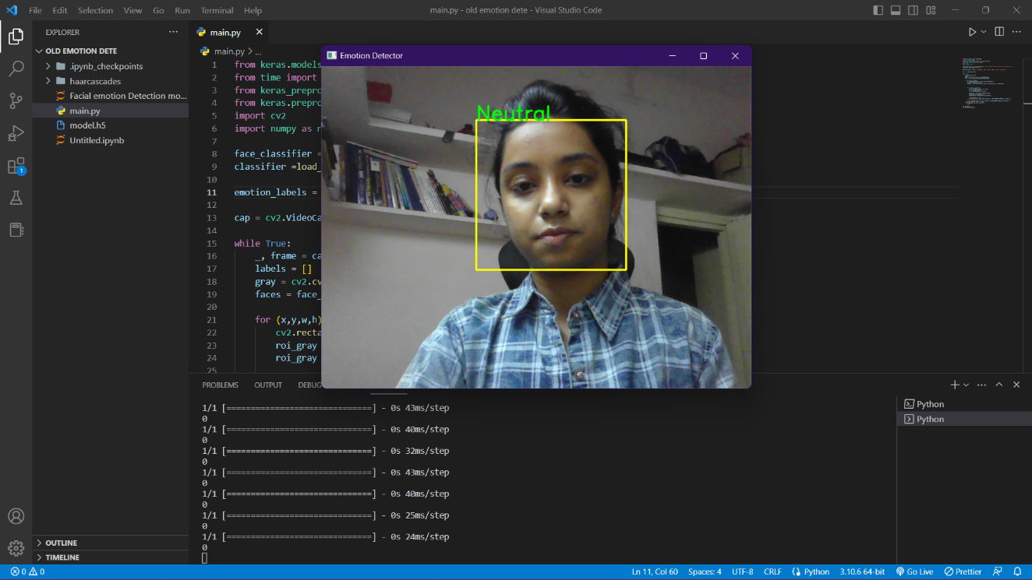
Fig.3 : Output Recognizing emotion as neutral.

Slide 17
APPLICATIONS OF THE PROJECT
Human-Computer interaction
Virtual Reality
Healthcare
Market Research
Entertainment

Slide 18
GOALS AND OBJECTIVE OF INTERNSHIP
Skill development.
Career exploration.
Networking.
Work experience.
Industry knowledge.
Professional development

Slide 19
RESULTS
Improved skills.
Increased confidence.
Career clarity.
Real-world experience.
Professional references.

Slide 20
THANK YOU

